Slide 1

CIS017-1 – Computer Systems Structure CIS095-1 – Databases and Computer Networking
Lecture – Data Modelling and Entity Relationship Models

Slide 2

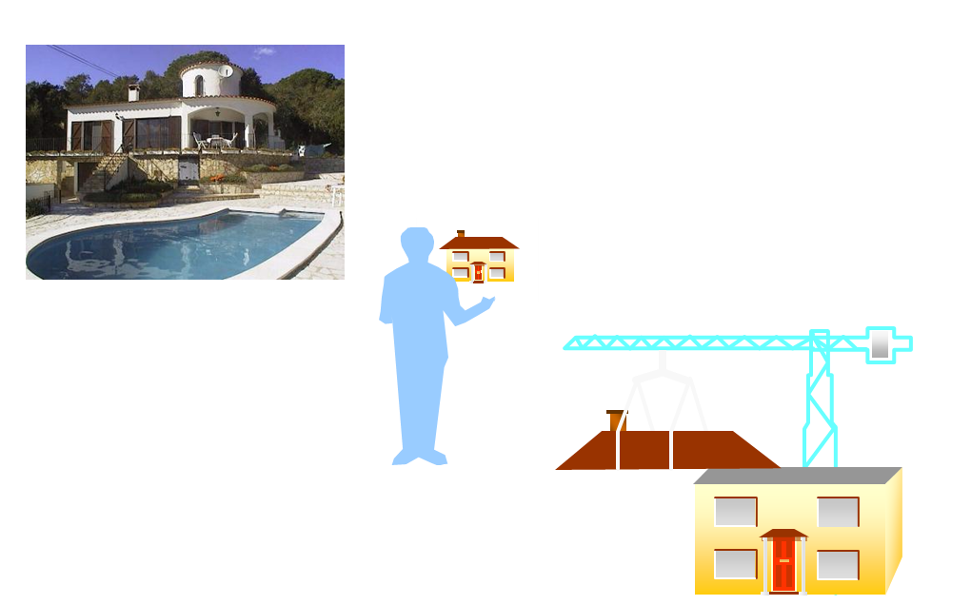
Turning reality into a dream…

Slide 3
Introduction
Database Design
Conceptual Data Model
Logical Data Model
For practical purposes we need not consider the differences between a conceptual data model and a logical data model. Nowadays, they are largely irrelevant.
Physical Data Model
This maps the data model to the selected RDMS, and describes how data is stored within the constraints and specifications of the RDMS

Slide 4
Conceptual Data Model
This takes a top-down approach to data modelling
Compare the bottom-up approach – normalisation (to be covered later)
Conceptual data modelling looks at the system as a whole and identifies objects or ‘things’ for which data needs to be stored Objects of significance to the business…..
An alternative or addition to this approach is using UML (Unified Modelling Language) for data modelling

Slide 5
Conceptual Data Model
These objects are known as entities
It identifies the relationships between entities, and the relationship type
It identifies where relationships need to become entities in their own right

Slide 6
Conceptual Data Model
Introduction of the key role players:
Entities
Attributes
Relationships

Slide 7
Conceptual Data Modelling
An Entity is:
“Something” of significance to the business about which data must be known.
A name for the things that you can list.
Usually a noun.
Examples: objects, events
Entities have instances.

Slide 8
Entities and Instances
Entity
PERSON
PRODUCT
PRODUCT TYPE
EMPLOYMENT CONTRACT
JOB
SKILL LEVEL
TICKET RESERVATION
PURCHASE
ELECTION
PRINTER PREFERENCE
DOCUMENT VERSION
Instance
Mahatma Gandhi
2.5 x 35 mm copper nail
nail
my previous contract
violinist
fluent
tonight: Hamlet in the Royal
the CD I bought yesterday
for parliament next fall
…
...

Slide 9
Attribute Instances
Entity
EMPLOYEE
CAR
ORDER
JOB
TRANSACTION
EMPLOYMENT CONTRACT
Attribute
Family Name, Age, Shoe Size,
Town of Residence, Email, ...
Model, Weight, Catalog Price, …
Order Date, Ship Date, …
Title, Description, ...
Amount, Transaction Date, …
Start Date, Salary, ...

Slide 10
Relationships
Also represent something of significance to the business
Express how entities are mutually related
Always exist between two entities (or one entity twice)
Always have two perspectives
Are named at both ends

Slide 11
Relationship Examples
EMPLOYEES have JOBS
JOBS are held by EMPLOYEES
PRODUCTS are classified by a PRODUCT TYPE
PRODUCT TYPE is a classification for a PRODUCT
PEOPLE make TICKET RESERVATIONS
TICKET RESERVATIONS are made by PEOPLE

Slide 12
Employees have jobs
JOB
manager
Numerical observation:
All EMPLOYEES have a JOB
No EMPLOYEE has more than one JOB
Not all JOBS are held by an EMPLOYEE
Some JOBS are held by more than one EMPLOYEE
EMPLOYEE
cook
Shintaro
waitress
Jill
financial controller
Adam
Ahmed
waiter
porter
Maria
piano player

Slide 13
Conceptual Data Model
For each relationships, we will:
Name the relationship (in both directions)
Identify the degree or cardinality
One to One
One to Many
Many to Many
Identify the optionality
Mandatory
Optionality
Identify other constraints – 1…10, 0, 0…6 etc

Slide 14
Conceptual Data Model
We will ‘break down’ any Many to Many relationships – by defining an intermediate table.
We will identify Primary Keys and add other attributes.
We will identify Primary keys and Foreign key relationships
This will result in a set of skeleton tables (Entity Relationship Diagram) together with a list of table names (Primary Key, Foreign Key and other attributes) (Entity Relationship Model)

Slide 15
Conceptual Data Model
There are many different notations for ERMs (ie. SSADM etc). Mixing notations can be confusing.
We will use Oracle notation.

Slide 16
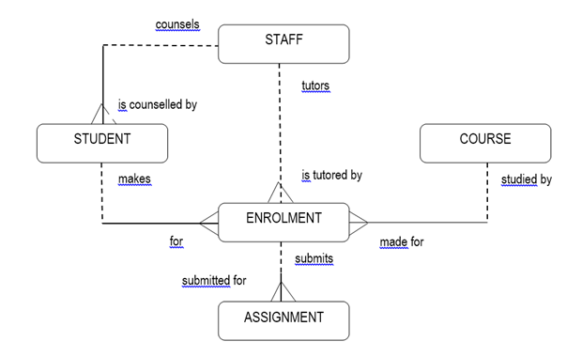
Conceptual Data Model

Slide 17
Conceptual Data Model
Entity Types
Student (StudentId, Name, Registered, Region)
Staff (StaffNo, Name, Region)
Course (CourseCode, Title, Credit, Quota)
Enrolment (StudentId, CourseCode)
Assignment (StudentId, CourseCode, AssgnmentNo, Grade)

Slide 18
Conceptual Data Model
Skeleton Tables with Foreign Keys
Student (StudentId, StaffNo*, Name, Registered, Region)
Staff (StaffNo, Name, Region)
Course (CourseCode, Title, Credit, Quota)
Enrolment (StudentId*, CourseCode*, StaffNo*)
Assignment (StudentId*, CourseCode*, AssgnmentNo, Grade)

Slide 19
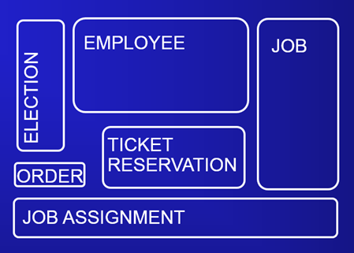
Entity Representation in Diagram
Drawn as a “softbox”
Name singular
Name inside
Neither size, nor position has a special meaning
During design, entities usually lead to tables.

Slide 20
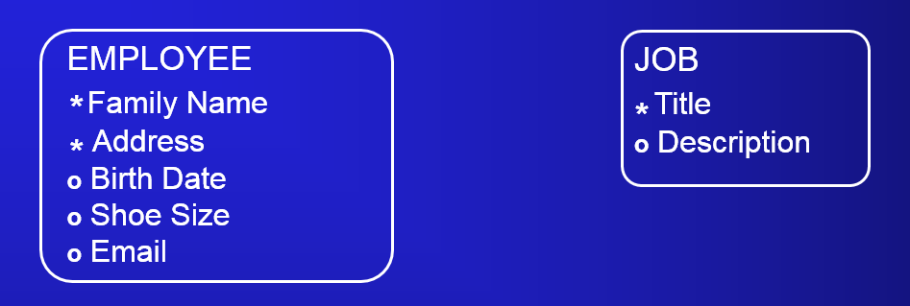
Attributes in Diagrams
Mandatory attribute, that is, known and available for every instance
Optional attribute, that is, unknown or unimportant to know for some instances
During design, attributes lead to columns.

Slide 21
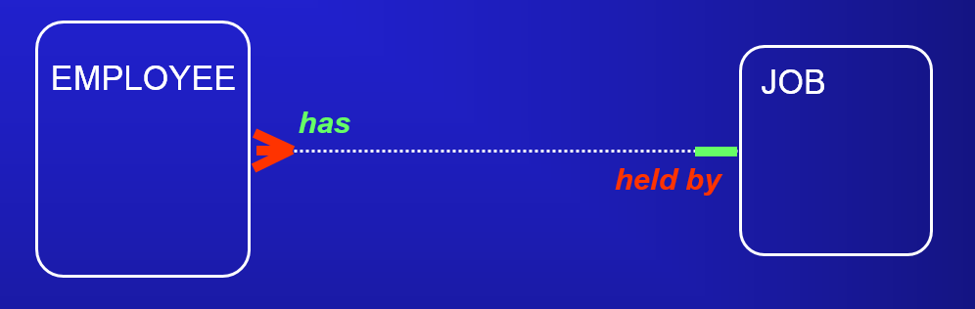
Relationship in Diagrams
An employee has exactly one job
Jobs are held by one or more employees

Slide 22
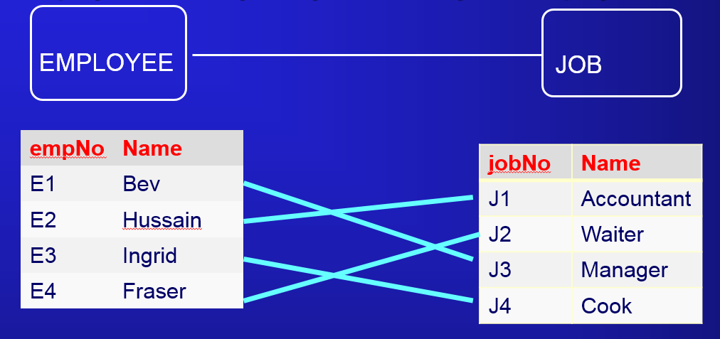
Relationship in Diagrams
An employee has one job. A job is held by one employee

Slide 23
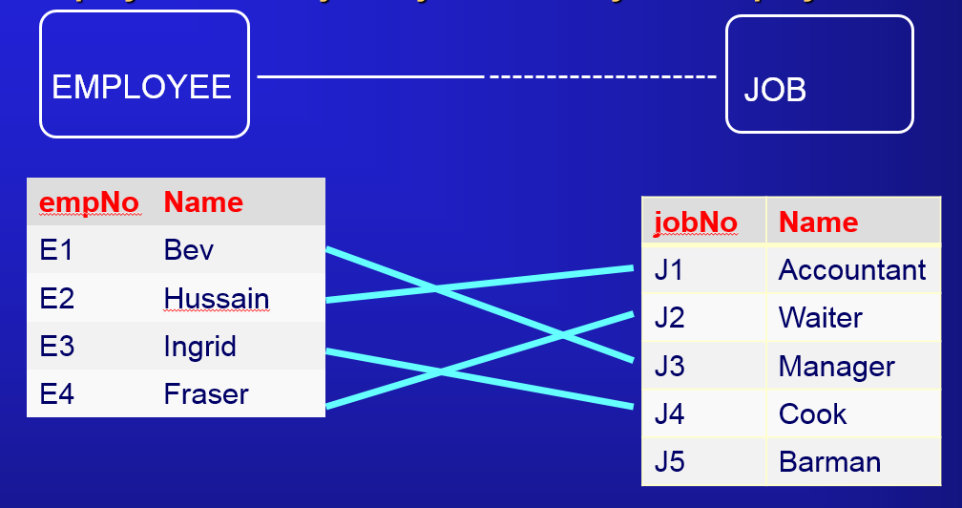
Relationship in Diagrams
An employee has one job. A job is held by one employee

Slide 24
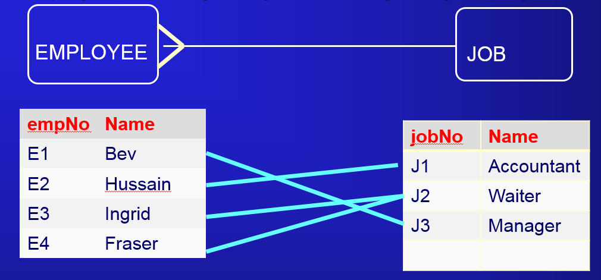
Relationship in Diagrams
An employee has one job. A job is held by many employees

Slide 25
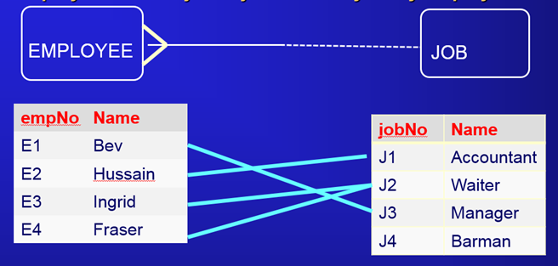
Relationship in Diagrams
An employee has one job. A job is held by many employees

Slide 26
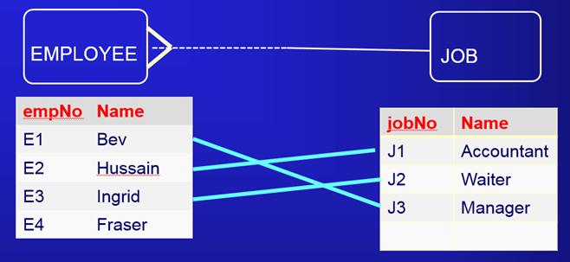
Relationship in Diagrams
An employee has one job. A job is held by many employees

Slide 27
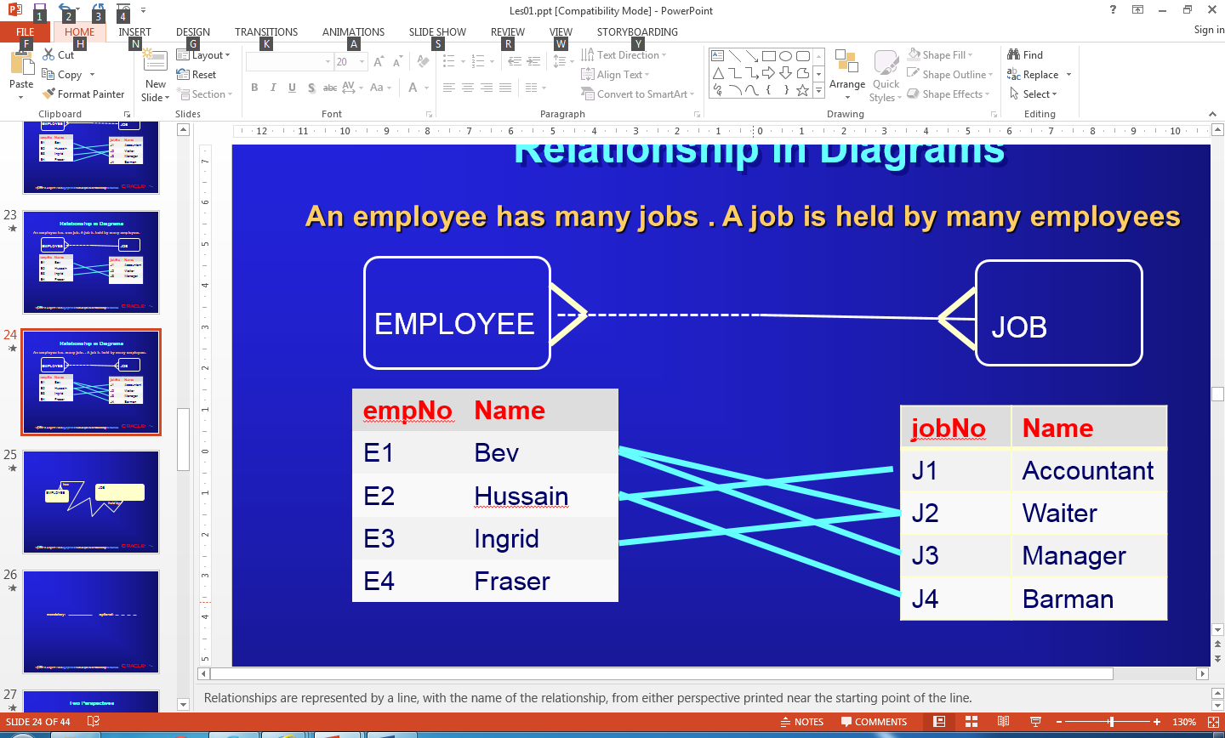
Relationship in Diagrams
An employee has many jobs . A job is held by many employees

Slide 28
Relationship in Diagrams
An employee has many jobs . A job is held by many employees

Slide 29
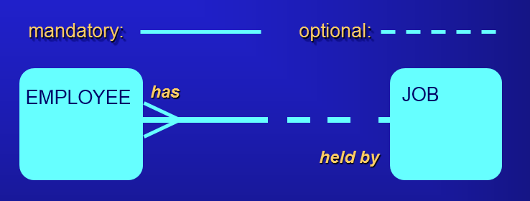
Relationship – Two Perspectives

Slide 30
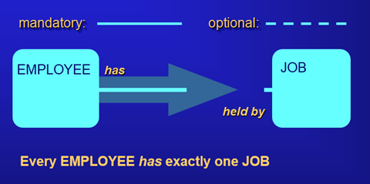
Relationship – One Way

Slide 31
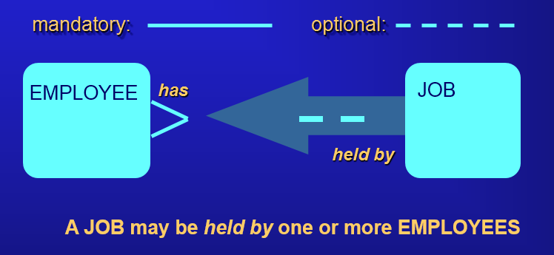
Relationship – The Other Way

Slide 32
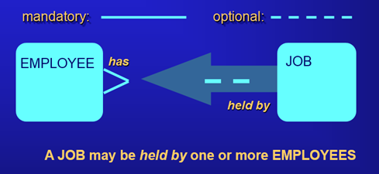
Reading a Relationship End

